Slide 1

A gamified introduction to Python Programming Lecture 4 Conditional statements (If/Elif/Else)
Matthieu DE MARI – Singapore University of Technology and Design

Slide 2

Outline (Chapter 4)
What are conditional statements?
How to use the if statement?
How to use the elif statement?
How to use the else statement?
What is dead code?
What are good practices when it comes to conditional statements?
What are nested ifs statements?
Practice on if/elif/else.

Slide 3
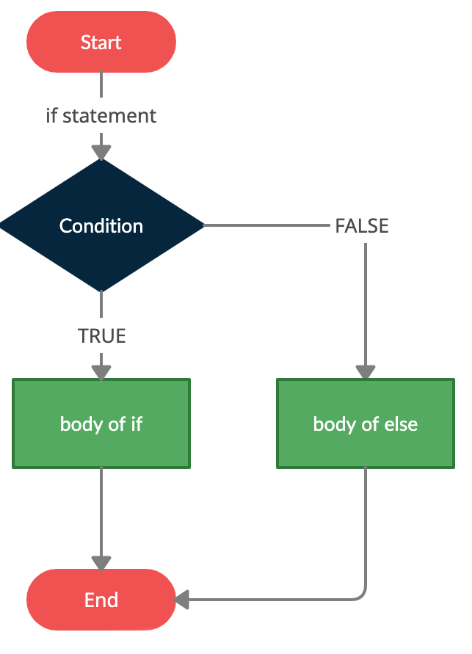
Conditional structures
Definition (conditional structure):
In programming, a conditional structure (or conditional statement) is a control flow statement that executes a block of code only if a specified condition or Boolean variable evaluates to True.
Using keywords such as “if”, “elif”, and “else” to define different execution paths, this mechanism allows programs to make decisions and perform different actions based on given conditions.

Slide 4
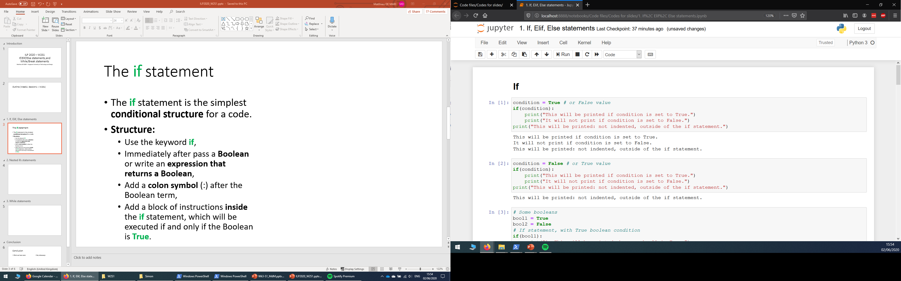
The if statement
The if statement is the simplest conditional structure.
Structure:
Use the keyword if,

Slide 5
The if statement
The if statement is the simplest conditional structure.
Structure:
Use the keyword if,
Immediately after, pass a Boolean variable or write an expression that returns a Boolean,

Slide 6
The if statement
The if statement is the simplest conditional structure.
Structure:
Use the keyword if,
Immediately after, pass a Boolean variable or write an expression that returns a Boolean,
Add a colon symbol (:) after the Boolean term,

Slide 7
The if statement
The if statement is the simplest conditional structure.
Structure:
Use the keyword if,
Immediately after, pass a Boolean variable or write an expression that returns a Boolean,
Add a colon symbol (:) after the Boolean term,
Add a block of instructions inside the if statement, which will be executed if and only if the Boolean is True (indented as in def).

Slide 8
The if statement
The if statement is the simplest conditional structure.
Structure:
Use the keyword if,
Immediately after, pass a Boolean variable or write an expression that returns a Boolean,
Add a colon symbol (:) after the Boolean term,
Add a block of instructions inside the if statement, which will be executed if and only if the Boolean is True (indented as in def).
Note: “inside” means your instructions are indented with 4 spaces more than the if statement. Jupyter will suggest indentations.

Slide 9
The if statement
The if statement is the simplest conditional structure.
How it works:
If the Boolean condition/variable specified for the if statement is True, then execute the block of code inside the if statement.
If the Boolean condition is False, ignore the block of code in the if statement.
Once we are done executing the code in if (or ignoring it), move on to the next (non-indented) line.

Slide 10
The if statement
The if statement is the simplest conditional structure.
How it works:
If the Boolean condition/variable specified for the if statement is True, then execute the block of code inside the if statement.
If the Boolean condition is False, ignore the block of code in the if statement.
Once we are done executing the code in if (or ignoring it), move on to the next (non-indented) line.

Slide 11
The if statement
The if statement is the simplest conditional structure.
How it works:
If the Boolean condition/variable specified for the if statement is True, then execute the block of code inside the if statement.
If the Boolean condition is False, ignore the block of code in the if statement.
Once we are done executing the code in if (or ignoring it), move on to the next (non-indented) line.

Slide 12
The if statement
The if statement is the simplest conditional structure.
How it works:
If the Boolean condition/variable specified for the if statement is True, then execute the block of code inside the if statement.
If the Boolean condition is False, ignore the block of code in the if statement.
Once we are done executing the code in if (or ignoring it), move on to the next (non-indented) line.

Slide 13
The if statement
The if statement is the simplest conditional structure.
How it works:
If the Boolean condition/variable specified for the if statement is True, then execute the block of code inside the if statement.
If the Boolean condition is False, ignore the block of code in the if statement.
Once we are done executing the code in if (or ignoring it), move on to the next (non-indented) line.

Slide 14
The if statement
The if statement is the simplest conditional structure.
How it works:
If the Boolean condition/variable specified for the if statement is True, then execute the block of code inside the if statement.
If the Boolean condition is False, ignore the block of code in the if statement.
Once we are done executing the code in if (or ignoring it), move on to the next (non-indented) line.

Slide 15



Please download and install the Slido app on all computers you use
What will be printed when we run this code?
ⓘ Start presenting to display the poll results on this slide.

Slide 16
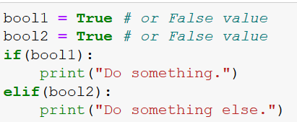
The elif statement
The elif statement (short for “else-if”) is used to define another conditional test to be executed, if and only if the previous if statement has failed.
Structure:
Write your if block as before
On the same indentation level as your if statement, write you elif statement (elif + Boolean condition + colon symbol)
Add your instructions inside the elif, by indenting your code as in if.

Slide 17
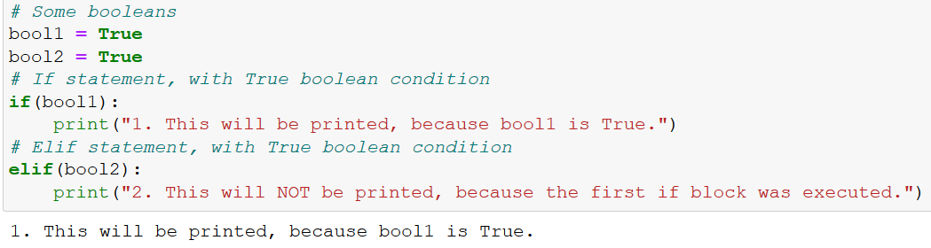
The elif statement
How it works:
If the Boolean in the if statement is True, execute the code inside the if, ignore the elif.
Did not execute even though bool2 was True.

Slide 18
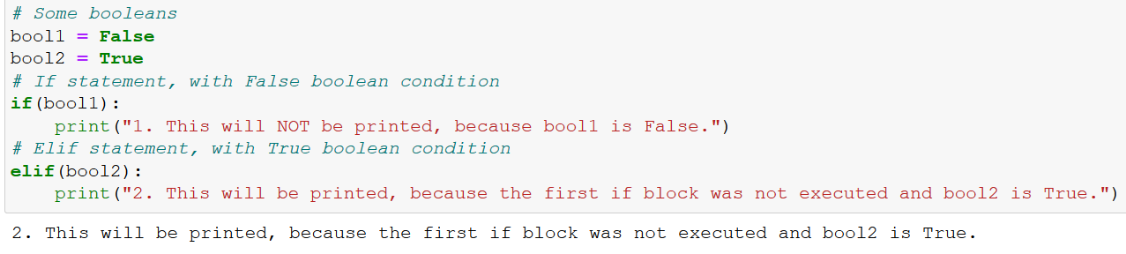
The elif statement
How it works:
If the Boolean in the if statement is True, execute the code inside the if, ignore the elif.
Otherwise, check for the Boolean in elif, and execute the code indented inside the elif, if this second Boolean condition is True. Otherwise, ignore it.

Slide 19
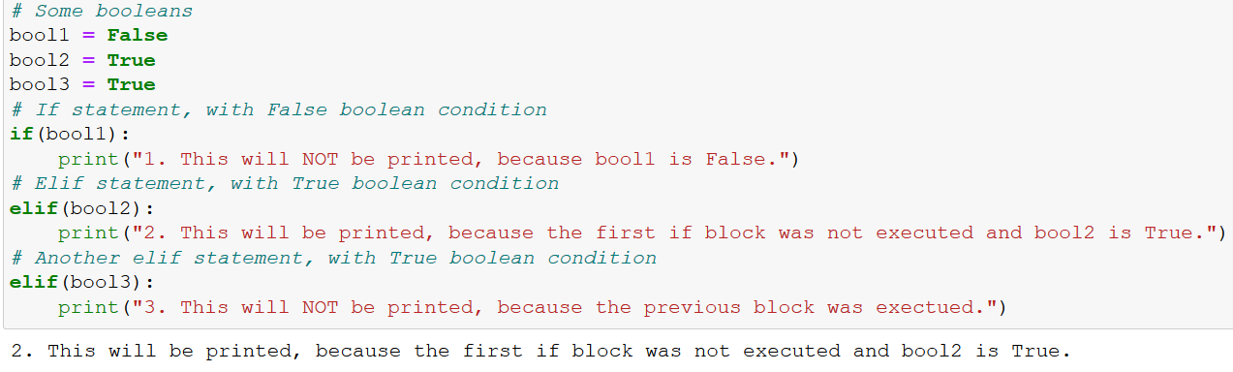
The elif statement (multiple blocks)
Multiple elif statements can be added after a single if statement.
In this case, execute the code inside an elif, if and only if:
all the previous if/elif have failed,
and its Boolean condition is True.

Slide 20
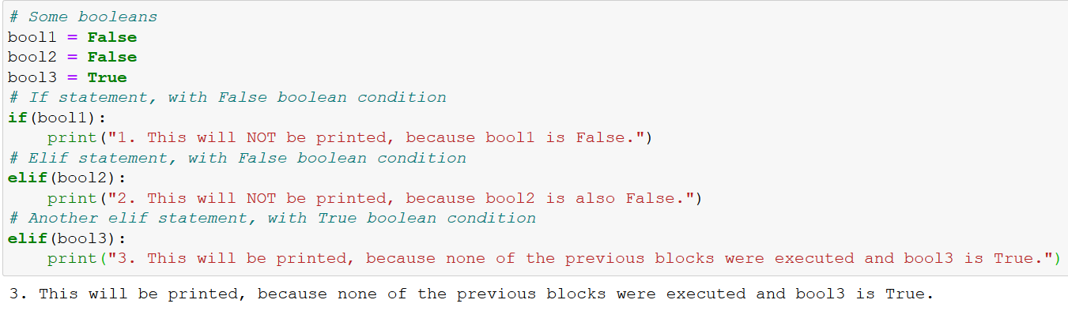
The elif statement (multiple blocks)
Multiple elif statements can be added after a single if statement.
In this case, execute the code inside an elif, if and only if:
all the previous if/elif have failed,
and its Boolean condition is True.

Slide 21
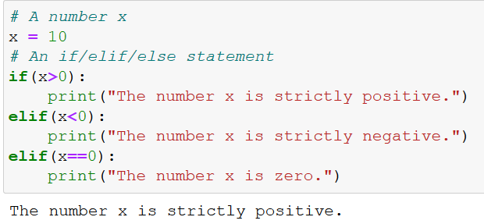
An example of if/elif code
Example: write a code that receives a number x, and prints one of the following prompts, accordingly:
“x is strictly positive.”
“x is strictly negative.”
“x is zero.”
We can use the if/elif structure to program that!

Slide 22
Please download and install the Slido app on all computers you use
What will be printed when running this code?
ⓘ Start presenting to display the poll results on this slide.

Slide 23
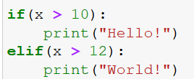
Dead code
Definition (dead code): We call “dead code” a piece of code that was written but is never going to be executed. Often, due to bad structure in code.
Question: can you spot the line, which will never be executed, no matter what the value of x is?
Why is it dead code?

Slide 24
Dead code
Definition (dead code): We call “dead code” a piece of code that was written but is never going to be executed. Often, due to bad structure in code.
Question: can you spot the line, which will never be executed, no matter what the value of x is?
Why is it dead code?
Dead code
Reason: Variable x cannot be both lower than 10 and greater than 12.
We need the if block to fail, for the elif to be checked. It means x must be lower than 10. But then, passing the Boolean condition in the elif requires having x greater than 12. Impossible conditions.

Slide 25
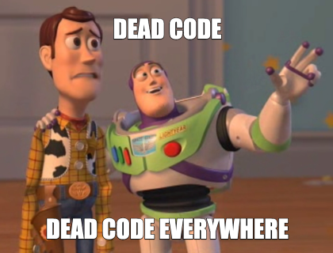
Dead code
The life of a CS teacher reviewing student codes
Definition (dead code): We call “dead code” a piece of code that was written but is never going to be executed. Often, due to bad structure in code.
Question: can you spot the line, which will never be executed, no matter what the value of x is?
Why is it dead code?

Slide 26

Matt’s Great advice
Matt’s Great Advice: Avoid dead code, by drawing structural diagrams and spending time figuring out the logic using pen and paper.
Dead code, usually follow from a poor design in your code.
Drawing a structural diagram, before coding, greatly helps figuring out the right structure for your code and avoid dead code.
There is never a scenario where we want our code to contain dead code.

Slide 27
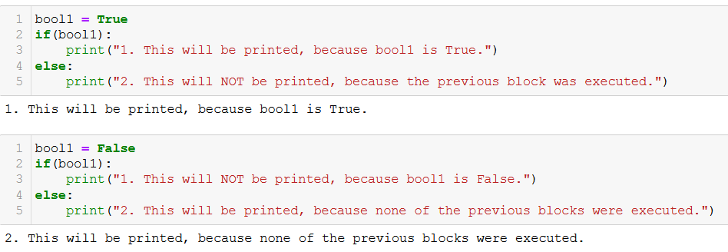
The else statement (no elif example)
The else statement is used to define a block of code to execute, if and only if ALL the previous if/elif statement have failed.
Same structure as an elif, but…
Comes last, after all the if/elif statements.
No Boolean condition to be checked.

Slide 28
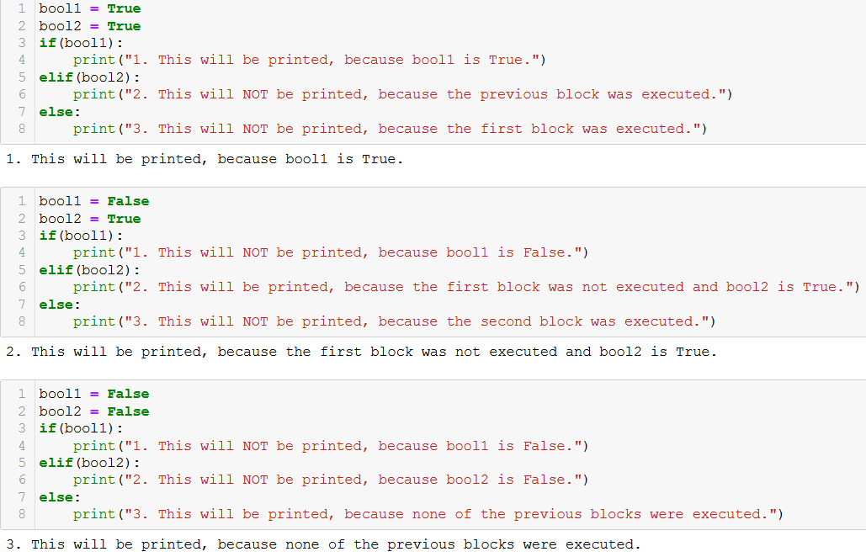
The else statement (multiple elif example)

Slide 29
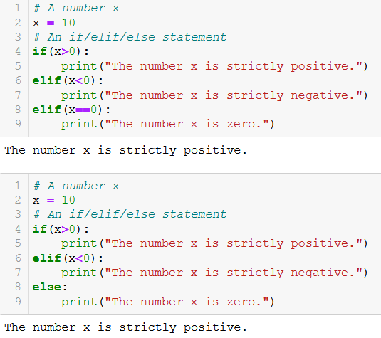
Our previous if/elif example, turned into an if/elif/else example
Technically, these two code on the right are equivalent
If we reach the last elif, that means the first two Boolean questions (x>0 and x<0) have failed.
At this point, we are guaranteed that x is probably zero.
It can then be replaced with an else.

Slide 30
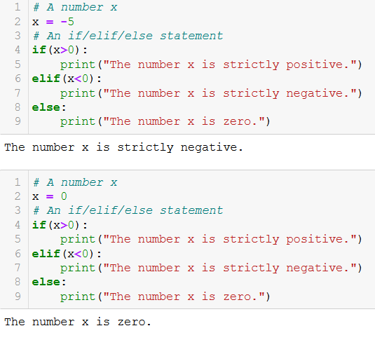
Our previous if/elif example, turned into an if/elif/else example

Slide 31
Please download and install the Slido app on all computers you use
How many elif statements can you use in an if/elif/else structure in Python?
ⓘ Start presenting to display the poll results on this slide.

Slide 32
Practice activities for if/elif/else
Let us practice the if/elif/else concepts a bit, with two activities.
Activity 1 – Ask for user’s age.ipynb
Activity 2 - Strength to lifepoints.ipynb

Slide 33
Activity 1 – Ask for user’s age
Write a function ask_user_age(), as described below.
It receives no parameters and returns no parameters.
It first asks for the user to input its age, and retrieves the info from the user.
If the age is negative (0 included), the function should print a message that reads "Your age cannot be negative, it must be at least 1."
If the age given by the user is larger than 122 (oldest person on record, Jeanne Calment), then the print should display "I really doubt you are ___ years old..." with the blank filled accordingly.
Otherwise, the function should print "Oh, you are ___ years old? That's cool!", with the blank filled accordingly.

Slide 34
Activity 2 - Strength to lifepoints
Write a function strength_to_lifepoints(), according to the following requirements.
This function receives a single parameter, strength_points, which corresponds to the number of strength points our main character has, and - for simplicity - will only take integer values.
This function returns a single output, lifepoints, which corresponds to the number of lifepoints our main character will have, based on its strength points.
Our main character has a base number of 50 lifepoints (that means it has 50 lifepoints, by default, if its strength is zero).
For each strength point, our hero will gain 10 extra lifepoints.
If the main character has at least 50 strength points, it gains a one-time bonus of 100 lifepoints, on top of the lifepoints it already has.
Finally, if the main character has at least 100 strength points, it gains another one-time bonus of 50% extra lifepoints, on top of all the lifepoints it already has and the previous bonuses.

Slide 35
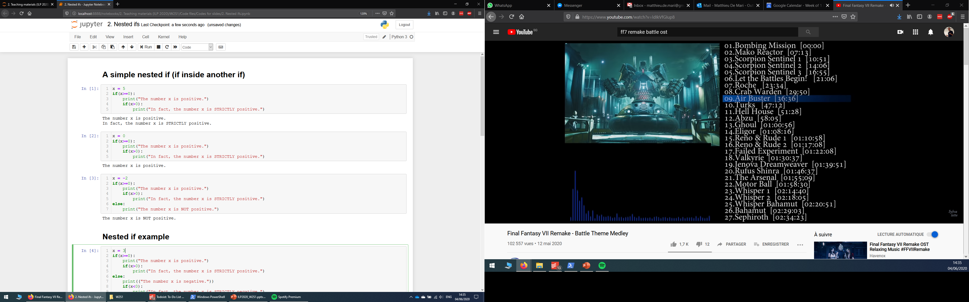
Nested if structures
Definition (nested if structure): A nested if structure is a structure which includes one or multiple if statement(s), inside another if statement.
These are typically used to check additional/subsequent conditions, based on whether a first condition has been satisfied or not.
(Probably something we could have used in Activity 2?)

Slide 36
Nested if structures
Definition (nested if structure): A nested if structure is a structure which includes one or multiple if statement(s), inside another if statement.
These are typically used to check additional/subsequent conditions, based on whether a first condition has been satisfied or not.
Each if might have its own elif/else statements. Careful on the indentation levels for each!

Slide 37
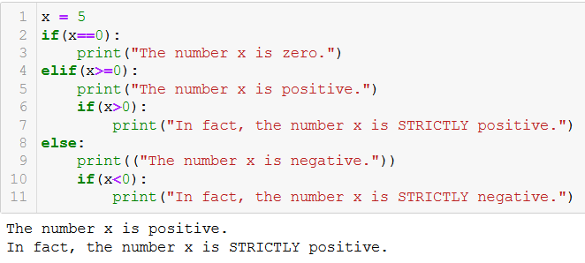
Nested if structures

Slide 38
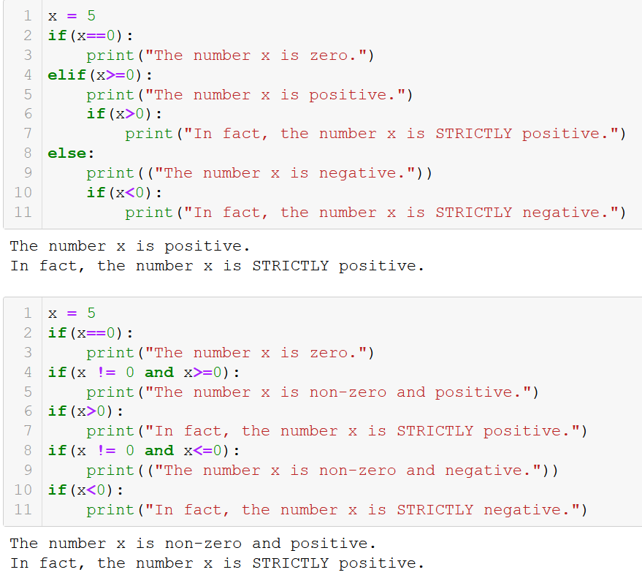
Nested if structures vs. combined conditionals
Nested if structures can, most of the time, be rewritten with combined conditionals (using and/or Boolean operators).
For instance, both structures on the right are equivalent.
→ Which design is better?
At this point, it is a matter of personal preference, use whatever feels more natural!

Slide 39
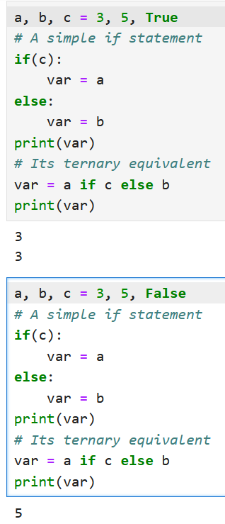
The ternary operator
Definition (ternary operator):
The ternary operator is a concise way to write some conditional expressions. Often used to dynamically decide on which value to assign to a variable based on certain conditions being met.
It is defined as “x = a if c else b”. Its effect is to assign the value a to x if c is True; and the value of b to x if c is False.
It can be seen as a short, condensed version of its equivalent indented if/else statement.

Slide 40
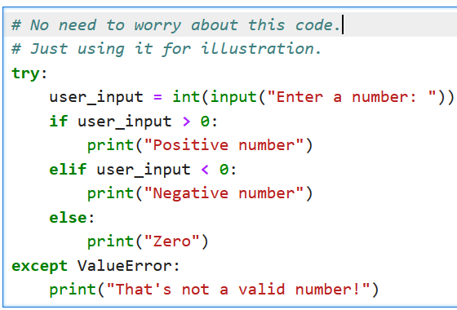
Quick note on If/Else vs. Try/Except
Bad practice: Using try/except instead of if/else conditional structures.
Many beginner students (especially those with background with the C language) use the try/except structure in place of if/else.
While it might lead to “similar outcomes”, try/except has a different purpose in Python, which is error handling.
For now, we should consider it malpractice. More details on how to properly use this structure in an upcoming lecture.

Slide 41
Conclusion (Chapter 4)
What are conditional statements?
How to use the if statement?
How to use the elif statement?
How to use the else statement?
What is dead code?
What are good practices when it comes to conditional statements?
What are nested ifs statements?
Practice on if/elif/else.

Slide 42
Activity 3 - Race and class check
Write a function character_creation(), according to the following requirements.
The function will receive two parameters: user_race and user_class.
For simplicity, only three races are available: Human, Elf, and Dwarf.
For simplicity, only four classes are available: Warrior, Hunter, Mage and Priest.
Humans can play all classes.
Elves cannot be warriors.
Dwarves cannot be mages or priests.
The function should not return anything.
It should print "You cannot play a character that is ...{race} and ...{class}.", with blanks filled accordingly, if the combination of user_race and user_class is not acceptable.
Not acceptable here means that its race and/or class is not among the ones listed above, or the combination is not permitted, as listed above.
If the combination is valid, it should print "Your character's race is ...{race} and your character's class is ...{class}.", with blanks filled accordingly.

Slide 43
Up for a challenge? (in the Extra challenges folder)
Activity 2+ - Strength to lifepoints (extra challenge).ipynb
Redo the activity 2, but this time…
Do not use any conditional statement (if/while) or ternary operator.
The function should only contain one line, which starts with return.

